Slide 1
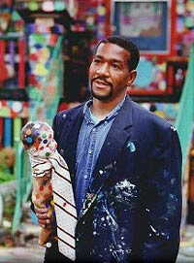

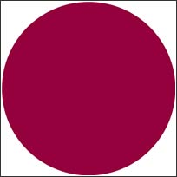
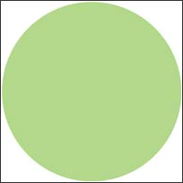
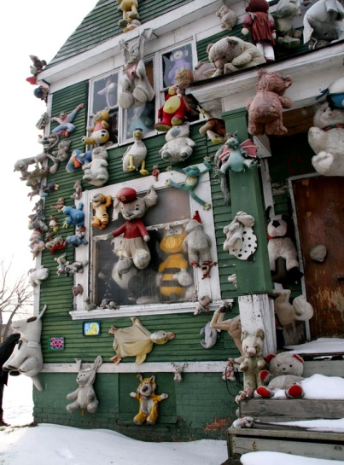
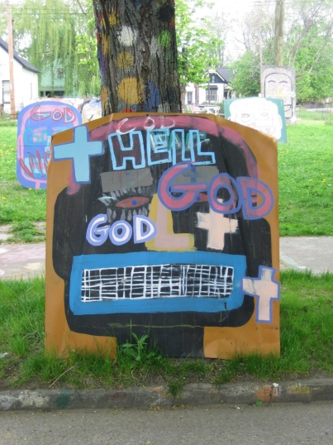
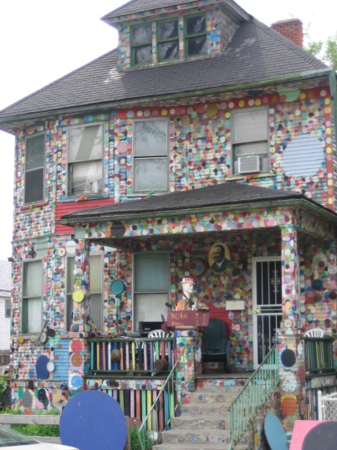
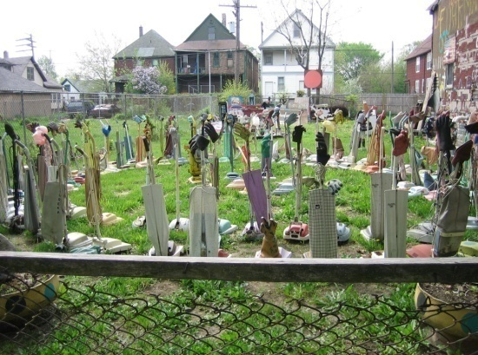
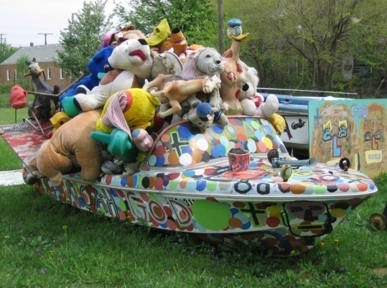
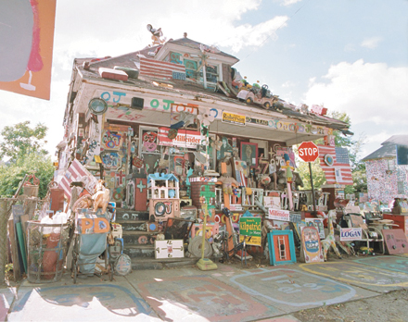
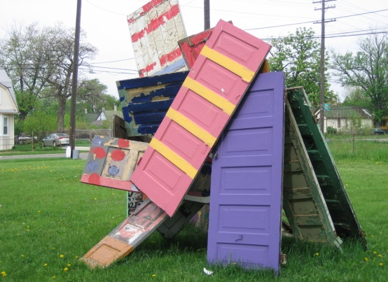
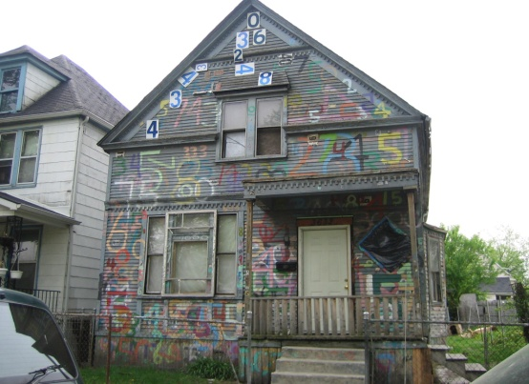
Tyree Guyton’s
Heidelberg Project
"I set out to change the world and that change starts with me... and by changing me, I'm changing the world" ~Tyree Guyton

Slide 2
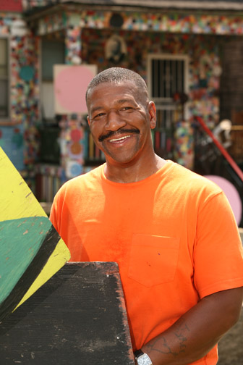

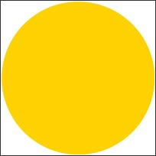


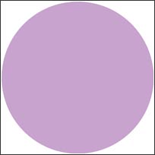
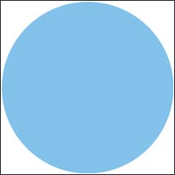


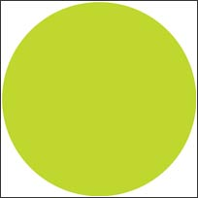
TYREE GUYTON
Tyree Guyton was born on August 24, 1955 in Detroit, Michigan. He created the Heidelberg Project in 1986 with his grandfather Sam Mackey as an outdoor art environment on Detroit's eastside, a neighborhood referred to as "Black Bottom.” The Heidelberg Project is, in part, a political protest, as Tyree's childhood neighborhood began to deteriorate after the 1967 riots. At first, the project consisted of his painting a series of houses on Detroit's Heidelberg Street with bright dots of many colors, and attaching salvaged items to the houses. It was a constantly evolving work that transformed a hard-core inner-city neighborhood where people were afraid to walk, even in daytime, into one in which neighbors took pride and where visitors were many and welcomed. His main goal was to develop the Heidelberg Project into Detroit’s first indoor and outdoor museum, complete with an artists' colony, creative art center, community garden, amphitheater, and more. The effect of the Heidelberg Project is displayed through the development of Heidelberg Street. At the other end of the street, there are crumbling houses with lawns covered with waist-high weeds, rubble and rubbish, with no people in sight. Nevertheless, the Heidelberg Project attracts nearly 275,000 visitors a year, and is now considered a recognized destination for Detroit tourists.

Slide 3

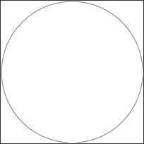
THE DOTTY WOTTY HOUSE
THE DOTTY WOTTY HOUSE
THE DOTTY WOTTY HOUSE
THE DOTTY WOTTY HOUSE
THE DOTTY WOTTY HOUSE
THE DOTTY WOTTY HOUSE
THE DOTTY WOTTY HOUSE
In 1991, Tyree Guyton created the Dotty Wotty House on Heidelberg Street. The Dotty Wotty House is Tyree’s grandfather’s house. He painted the house with multi-colored polka dots, which represent the many colors of all people. The intent of the Dotty Wotty House is to promote love, understanding, peace, and harmony of all races of people.

Slide 4

Faces in the Hood
The likeable faces decorating abandoned car hoods are representations of people of all races and backgrounds. Tyree painted these faces because he believes we are all created in God’s image. The faces remind us that although we are all different, we all need peace and harmony together. The faces are painted visions of the many souls who touch our lives each day.

Slide 5

THE PARTY ANIMAL HOUSE
Tyree created the Party Animal House to remind us that life can be a party if we lighten our hearts with love. When we truly respect and honor one another, we can begin new friendships that make life an enjoyable, loving experience.

Slide 6

THE OVAL ROOM
The Oval Room contains vacuum cleaners with gloves on their handles. The gloves are symbolic of no one getting their hands dirty while cleaning up Detroit. The vacuum cleaners sit their poised and ready to clean up Detroit. The vacuum cleaners ask their viewers if they will help them clean up Detroit and will the viewers help them clean up Detroit correctly.

Slide 7

NOAH’S ARK
The Bible story of Noah’s Ark became symbolic of a safe haven for Noah, his family, and all of the animals on earth. Noah’s Ark on Heidelberg Street represents how the Heidelberg Project has become an ark of safety for the community.

Slide 8

DOORS OF OPPORTUNITY
The Doors of Opportunity show that cooperation and dependence on one another is important in life. We all must support each other. That is the only way we can move into the future with harmony. The doors are of every shape and hue. There are so many paths in life to choose, it’s important to follow your heart. Walk through any doorway you choose, that is the only way to start!

Slide 9
THE HOUSE THAT MAKES SENSE
The House That Makes Sense is also called the Penny House. It was formally known as the OJ House (Obstruction of Justice House) and is currently being transformed into a center for art that will include galleries, artists in residence, studios, a library, and a gathering center for children. It will serve the community in a positive way. It will soon be covered with 800,000 pennies. Through this creative endeavor, opportunities for economic development will bring hope to its residents. Tyree tells his community with this project, “be ready for change.”

Slide 10

THE HOUSE OF NUMBERS
The House of Numbers has meaning from different perspectives. For the children, it is a larger-than-life counting block and a delightful way to learn and practice counting numbers. For the average adult, it is a curious puzzle. For Tyree, it means, “our days on earth are numbered,” therefore, let’s make our days count.

Slide 11
REFLECTION
“It’s all about the people, who deserve a better community and a better world. In my own way, I’m trying to make that happen.” ~Tyree Guyton
“Guyton’s Heidelberg Project shines like a jewel in the still-wounded city.” ~Thomas McEvilley, department chair of art criticism and writing at the School of Visual Arts (New York)
“Guyton's art is his own. His creations are affable and gratifyingly accessible. Through them, he seems to be committed to saving the world.... Guyton is a gifted, committed artist to whose probing, good natured truths attention should be paid." ~Roger Green, Ann Arbor News

Slide 12
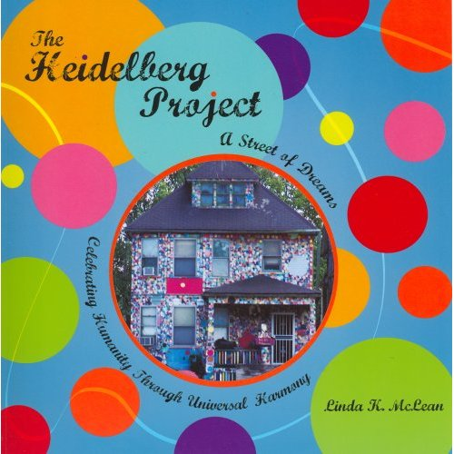
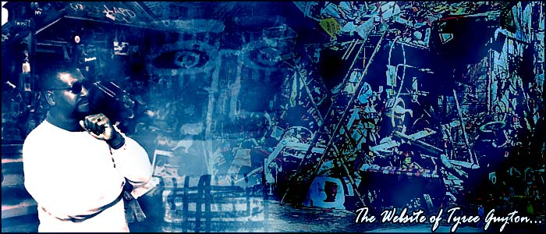
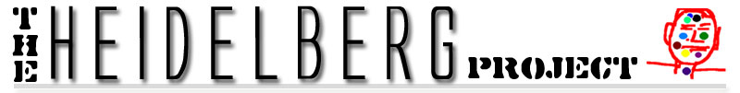
RESOURCES
The Heidelberg Project: A Street of Dreams by Linda K. McLean
Quotes about Tyree and the Heidelberg Project
Tyree Guyton Homepage:
The Heidelberg Project Website:

Slide 13
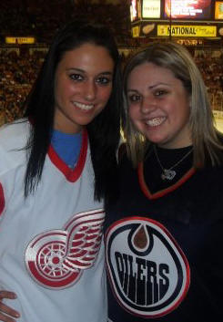
CREDITS
Lauren Ealba was first introduced to the Heidelberg Project and Tyree Guyton in 1996. In that year, her sixth grade class took a field trip to the Heidelberg Project, and since that point, Lauren has been a fan of both Tyree Guyton and the Heidelberg Project. Moved by Tyree’s art, Lauren returns to the Heidelberg Project every week to see the changes and keep in contact with Tyree.
Lauren takes much pride in the city of Detroit and is always eager to share the best parts of the city with her family and friends. The first place she always takes her guests is the Heidelberg Project. The Heidelberg Project has easily been one of the greatest influences on Lauren’s life. She hopes with this presentation, she can spread awareness and inspire others with Tyree’s vision and art.

